Slide 1
How To Help Myself When Playing With Friends
A special story just for AJ!

Slide 2
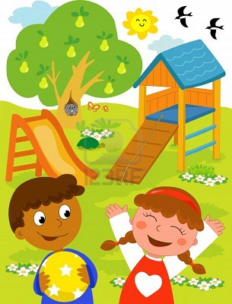
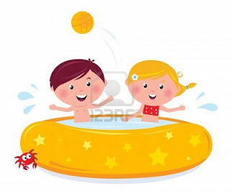
AJ is a great friend to others!
I love playing with all my friends:
  friends from school
  friends from church
  friends from home
I also love to meet new friends at the different places I go:
  the bounce house
  the pool
  the park

Slide 3

Playing With Friends…
When I play with my friends, these things are EXPECTED:
  Sharing my toys
  Taking turns
  Saying No (Qualify this)
  Asking for help
  Learning about others

Slide 4
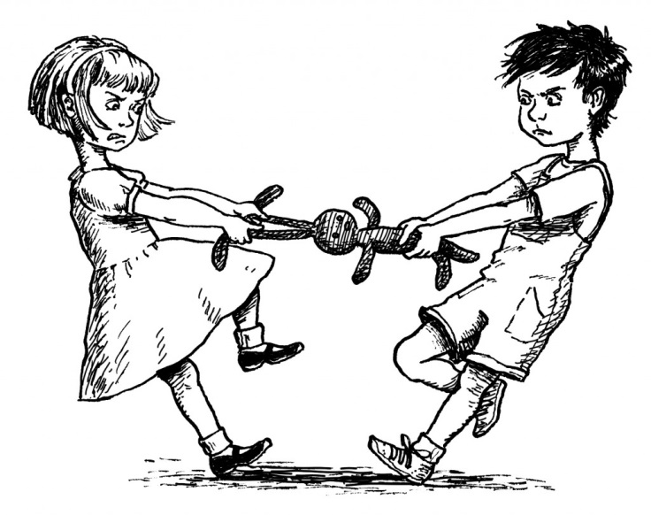

Playing With Friends…
Some friends haven’t learned how to play in an expected ways. Some friends don’t return a toy when it is my turn. When this happens, it is UNEXPECTED!

Slide 5
When the UNEXPECTED happens?
When the UNEXPECTED happens, and my friend won’t return my toy, sometimes I am confused.
  One thing I can try is to use my words. I can say things like:
    “You had a turn. Now it’s my turn.”
    “I would like to have my toy back now.”
    “Here’s another toy for you to play with. I want my toy back”
  These words might help me get my toy back. If they still won’t give me my toy back, I can find another toy to play with and wait until they are finished.

Slide 6
Write conclusion

